Slide 1
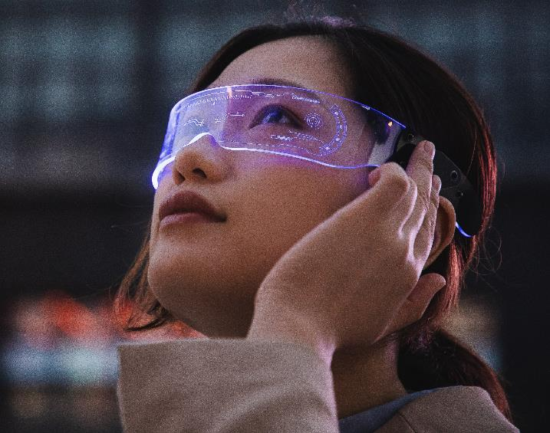
Study of virtual and augmented reality
( Characteristics, Applications, and Scope )
Atia Naim
A2305222498
3-CSE 8X

Slide 2

INTRODUCTION
Welcome to the presentation on Vr and ar technology analysis.
This presentation aims to explore the characteristics, applications, and potential of these across various domains.

Slide 3
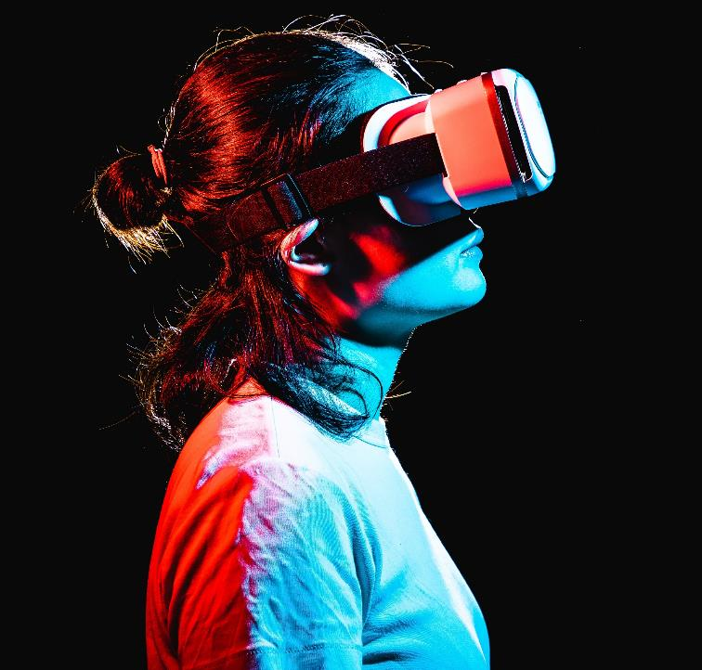
Virtual Reality (VR)
Virtual Reality (VR) creates computer-programmed 3D environments for users to explore.
VR experiences can range from real-world-like scenarios to entirely new and imaginative realms.
VR provides a stimulating and immersive experience that can be similar to or different from the real world.

Slide 4
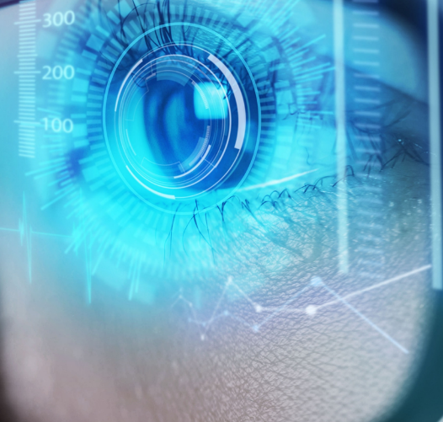
Augmented Reality (AR)
Augmented Reality (AR) overlays virtual content onto the real world.
AR enhances the user's perception of reality by integrating computer-generated elements in real-time through cameras or sensors.
AR bridges the gap between digital and physical experiences, creating an enhanced visual environment.

Slide 5
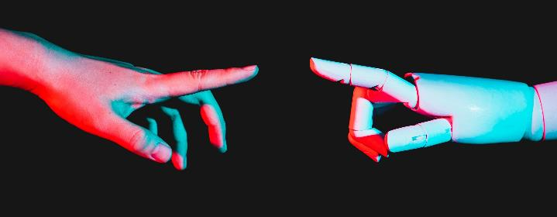
SIMILARITIES AND DIFFERENCES
SIMILARITIES​
DIFFERENCES
Immersive experience
Digital Interaction
Technology Dependence
Entertainment and Education
Environment
Interaction
Use cases
Device Requirements
Level of Immersion
Notes:
Similarities:
Immersive Experience: Both AR and VR aim to immerse users in a digital environment, enhancing their sensory experience beyond the physical world.
Digital Interaction: They both involve interacting with digital elements, whether they're virtual objects (VR) or digital overlays on the real world (AR).
Technology Dependence: Both rely heavily on technological components such as displays, sensors, cameras, and processing power.
Entertainment and Education: Both AR and VR have applications in entertainment, gaming, education, training, simulation, and various industries.
Differences:
Environment:
AR (Augmented Reality): AR overlays digital information onto the real world. Users can still see and interact with their physical surroundings while digital elements are integrated into their field of view. Examples include Pokémon GO and AR navigation apps.
VR (Virtual Reality): VR creates a fully immersive digital environment that replaces the real world. Users are completely immersed in a virtual space, often through headsets, and cannot see their physical surroundings. Examples include VR gaming and virtual tours.
Interaction:
AR: Interaction often involves gestures, voice commands, or physical objects that are recognized by AR devices. Users interact with both digital and physical elements.
VR: Interaction is primarily through motion controllers, gestures, and sometimes haptic feedback devices. Users interact with entirely virtual objects and environments.
Use Cases:
AR: Common use cases include enhancing real-world experiences (e.g., AR museum guides), navigation assistance, remote collaboration, and industrial applications (e.g., maintenance instructions).
VR: VR is often used for immersive gaming, virtual tours, simulations (e.g., flight or medical simulations), architectural visualization, and therapeutic applications (e.g., exposure therapy).
Device Requirements:
AR: AR can be experienced using various devices, including smartphones, tablets, AR glasses, and heads-up displays.
VR: VR typically requires specialized headsets that completely immerse users in the virtual environment. These headsets are often connected to powerful computers or gaming consoles.
Level of Immersion:
AR: AR maintains a connection with the physical world, allowing users to interact with both real and virtual elements simultaneously.
VR: VR provides a more intense level of immersion by completely replacing the physical environment with a virtual one, isolating users from their surroundings.

Slide 6
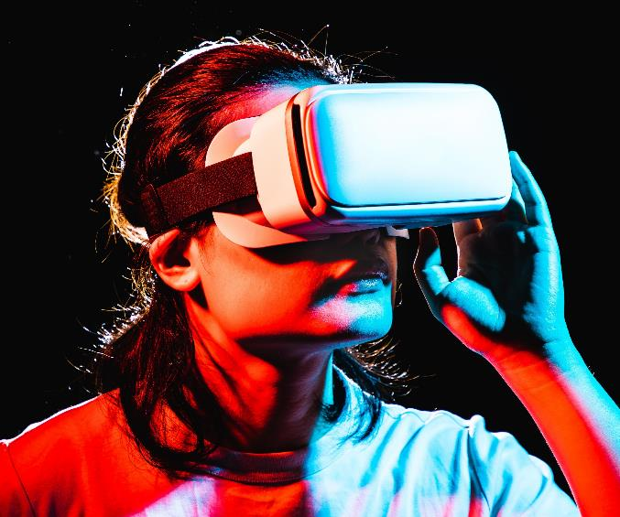
UNDERLYING technology
Relies on advanced technologies like computer graphics, tracking sensors, and displays.
Both technologies, work together to create seamless and convincing virtual and augmented experiences.

Slide 7
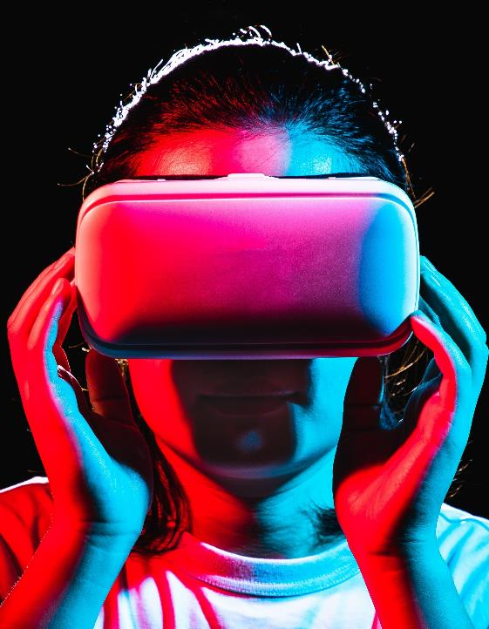
HARDWARE COMPONENTS
DISPLAY
TRACKING SENSORS
CONTROLLERS AND INPUT DEVICES
COMPUTING HARDWARE
AUDIO SYSTEM
CABLES AND CONNECTIONS
ACCESSORIES
BASE STATIONS

Slide 8

Software components
content creation
Audio and spatial sound
stimulation and interactions
User interface and interaction
Social and multiplayer

Slide 9
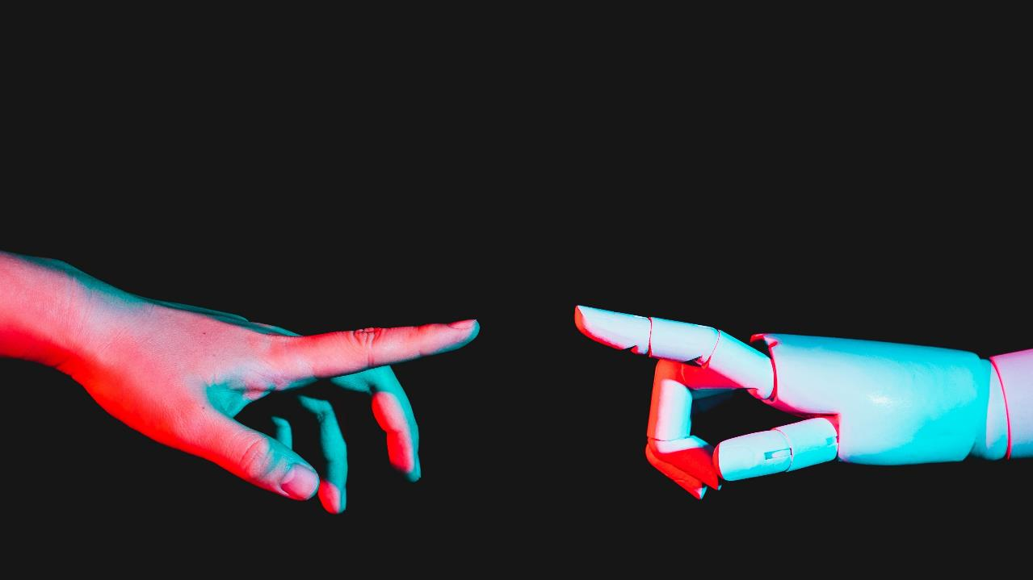
applications

Slide 10




gaming
Education
Healthcare
Architecture
Immersive gaming and interactive storytelling
Real-time educational stimulations and enhanced learning experience
Surgical training, patient education, and therapy applications
Virtual walkthroughs and 3D modelling.

Slide 11
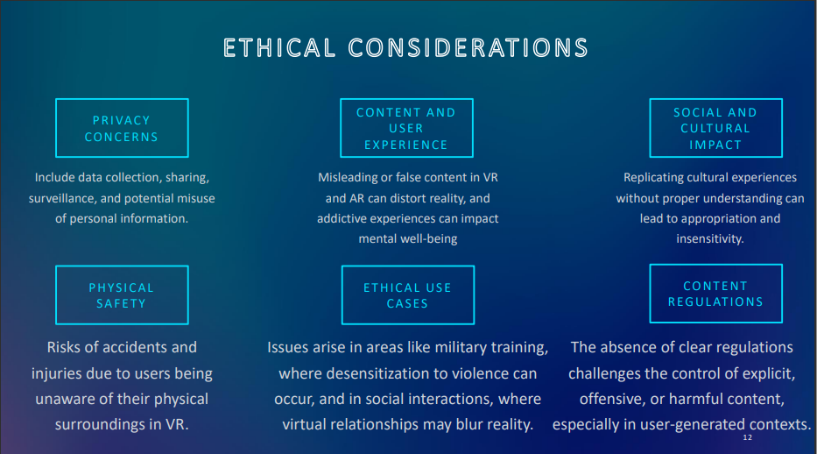

Slide 12
why this study?

Slide 13
Understanding the capabilities and WORKING of VR and ar is essential for making informed decisions.
THIS UNDERSTANDING DRIVES INNOVATION AND HELPS INDUSTRIES HARNESS THE POTENTIAL OF THESE TECHNOLOGIES EFFECTIVELY.

Slide 14

CONCLUSION
Education can be enhanced through lifelike simulations for training and learning.
Healthcare, therapy and medical training.
Industries like real estate, tourism, and automotive can benefit from virtual tours and design simulations.
Collaboration, art, fitness, and space exploration also harness their capabilities.

Slide 15
CONCLUSION
These technologies offer unique capabilities that impact various domains.
By comprehending their potential, we can drive positive change and innovation across sectors.

Slide 16
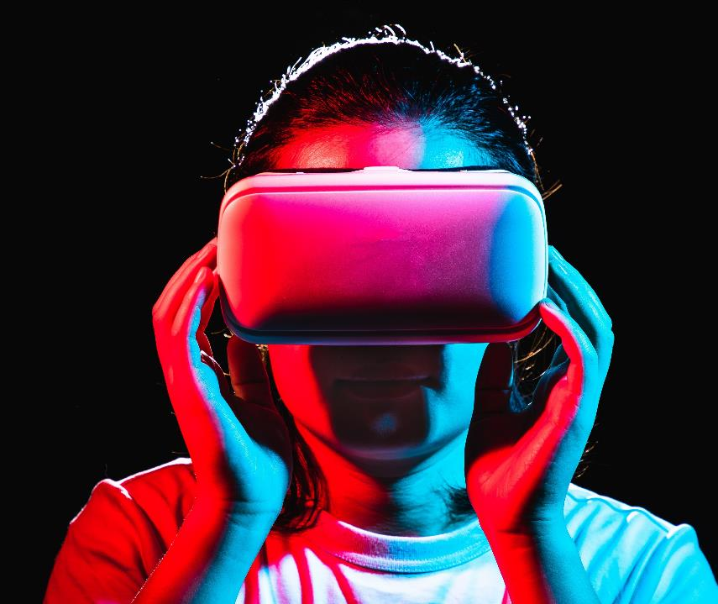
Thank you
ATIA NAIM
A2305222498
3-CSE 8X
atia.naim@s.amity.edu

